Slide 1
Predicting
Flight
Market Share
Presented by: Team 3

Slide 2
Table of contents
01
02
03
04
05
Overview
Conclusion
Data
Cleaning
Model
Training
Model
Evaluation

Slide 3
01
Overview
Objective and Data Description

Slide 4

The introduction
Objective:
Predict airline market share with regression analysis for strategic aviation insights
Data Description:
Source: US Bureau of Transportations
Variables: 38
Observations: 127,746
Description: Contains statistics on carriers based on different flight classes (passenger and freight)

Slide 5
02
Data Cleaning
Normalized data and created 'Market_Share' labels

Slide 6

Our method
We eliminated duplicates and missing values, selected relevant flight classes. Last, we generated the ‘Market_Share’ label for our model.

Slide 7
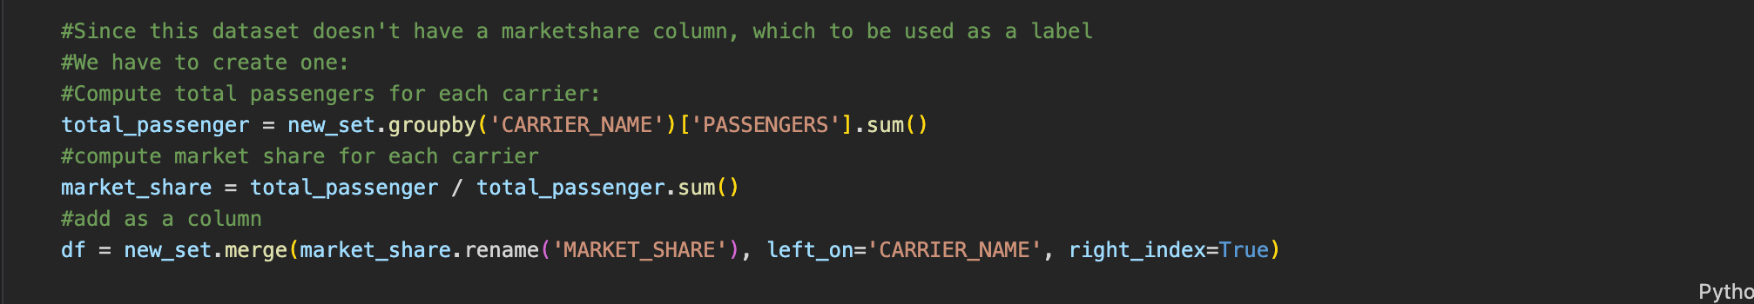
Data Processing & Cleaning
Data Discovering
Data Filtering
Label Column creation
Data loading (pd.read_csv)
Columns and rows exploration
Removed nulls and duplicates
Filtered to include only classes A,C,E,F and G.
Data now contained 101,456 record of scheduled passenger flights
After calculating each carrier’s total passengers, derived their market shares and merged as ‘Market_Share’ column into refined dataset

Slide 8
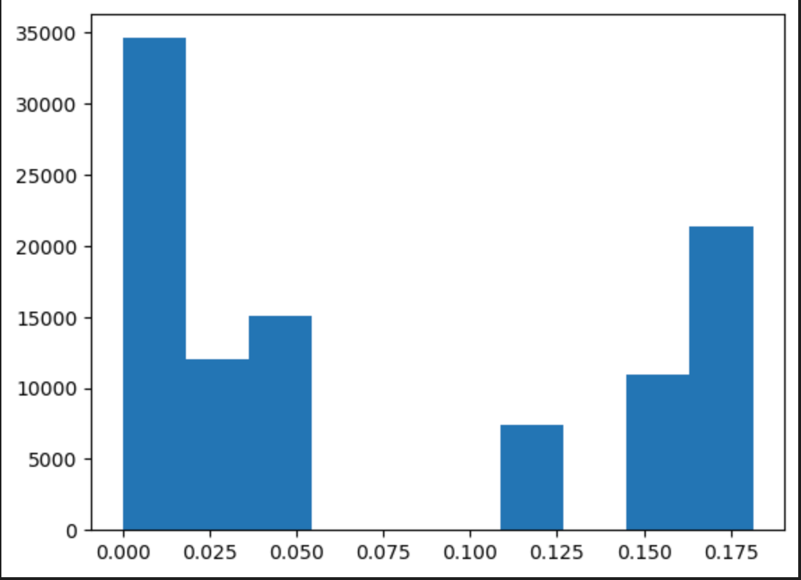
Label Column

Slide 9
03
Model Training
You can enter a subtitle here if you need it

Slide 10
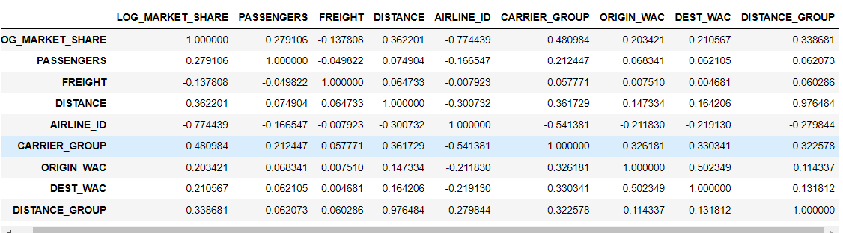
Correlation between the variables

Slide 11
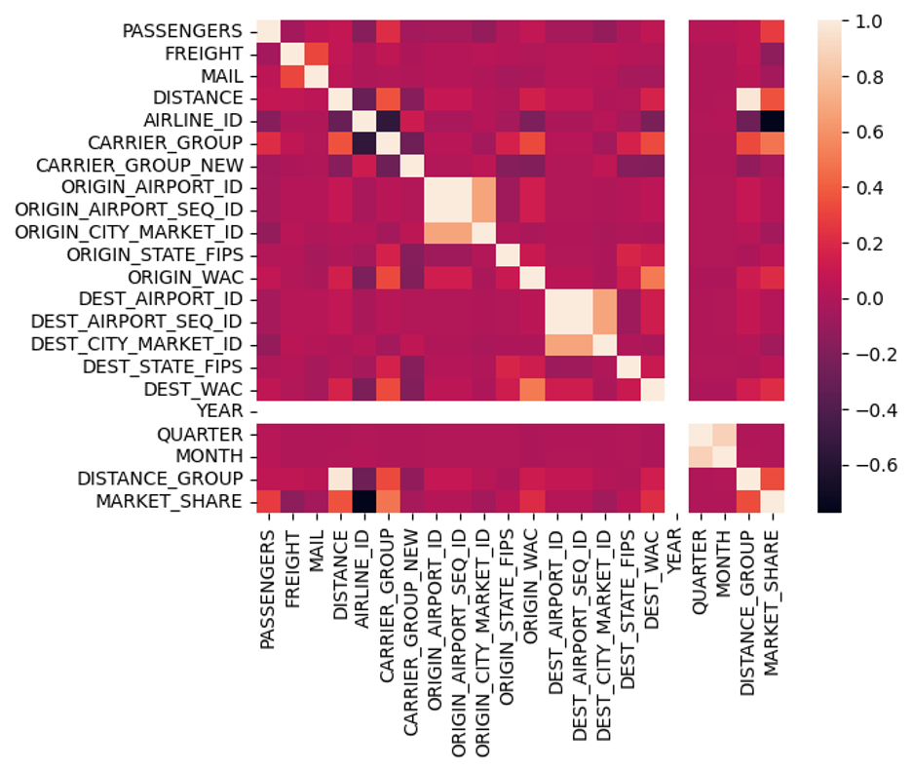
Correlation Analysis and Heatmap
PASSENGERS: 0.27910
DISTANCE: 0.36220
AIRLINE_ID: -0.773838
CARRIER_GROUP: 0.480922
DISTANCE_GROUP: 0.338246

Slide 12
Naive Model
Correlation Analysis
Data Processing
Computed correlations between variables.
Identified Relevant Columns: Selected columns with a correlation of at least 0.1 with 'LOG_MARKET_SHARE'
Selected features for modeling: ["PASSENGERS", "FREIGHT", "DISTANCE", "AIRLINE_ID", "CARRIER_GROUP", "DISTANCE_GROUP"].
Calculated Mean Squared Error (MSE) on the test set.
Notes:
MSE 0.000675
Built and evaluated a polynomial regression model for predicting log market share.
Got accuracy of 87% which show a good fit.
Consider further analysis, fine-tuning, or exploring other models for potential improvements

Slide 13
Lasso Regression Model
Lasso, or Least Absolute Shrinkage and Selection Operator, is a regression technique that adds the absolute values of the coefficients as a penalty term.
The L1 regularization penalty helps in shrinking some coefficients to exactly zero, effectively performing feature selection.
Reduction in the number of features simplifies the model and can improve its generalization to new, unseen data.
The sparsity introduced by Lasso helps mitigate the risk of overfitting, as the model becomes less sensitive to noise in the training data.

Slide 14
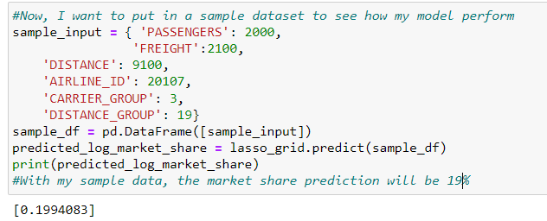
Model Performance in Lasso

Slide 15
Ridge Regression Model
Definition of Ridge Regression:
If you have many variables that might be related to each other, regular linear regression might give too much importance to certain variables, leading to less accurate predictions.
Ridge regression addresses this issue by adding a penalty for having large coefficients. This encourages the model to find a balance, considering all variables without letting one or a few dominate the prediction
The primary goal of Ridge Regression is to prevent overfitting by penalizing large values of the regression coefficients
Hyper Parameters used in this model :
Alpha= 0.01, 0.1, 1, 10, 100

Slide 16
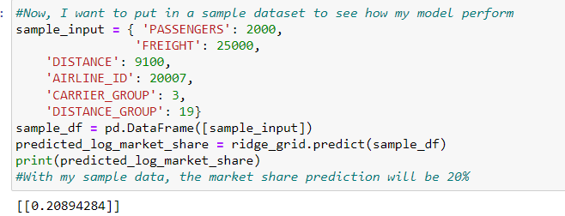
Model Performance in Ridge

Slide 17
04
Model Evaluation

Slide 18



["PASSENGERS","FREIGHT","DISTANCE","AIRLINE_ID","CARRIER_GROUP","ORIGIN_WAC","DEST_WAC","DISTANCE_GROUP"]
["PASSENGERS","FREIGHT","DISTANCE","AIRLINE_ID","CARRIER_GROUP","DISTANCE_GROUP"]
["PASSENGERS","DISTANCE","AIRLINE_ID","CARRIER_GROUP","DISTANCE_GROUP"]

Slide 19






["PASSENGERS","FREIGHT","DISTANCE","AIRLINE_ID","CARRIER_GROUP","ORIGIN_WAC","DEST_WAC","DISTANCE_GROUP"]
["PASSENGERS","FREIGHT","DISTANCE","AIRLINE_ID","CARRIER_GROUP","DISTANCE_GROUP"]
["PASSENGERS","DISTANCE","AIRLINE_ID","CARRIER_GROUP","DISTANCE_GROUP"]

Slide 20
Comparison
The linear regression model performs significantly better in terms of accuracy compared to Ridge and Lasso regression.
The Ridge and Lasso models, which include regularization terms, sacrifice some explanatory power (R-squared) for the benefits of reduced overfitting, improved generalization, and potentially simpler models.
Linear Regression MSE: 0.000675, Lasso Regression MSE: 0.0018145884012027655, Ridge Regression MSE: 0.0018145884012027655
The linear regression model has the lowest MSE among the models, suggesting that, on average, its predictions are closer to the actual values compared to Lasso and Ridge regression.
Lasso and Ridge regression, with higher MSE, may be sacrificing some accuracy in favor of preventing overfitting and promoting sparsity in the model.
Notes:
This could be because the linear model doesn't apply regularization and includes all available features without constraint.
Linear regression has the lowest MSE, the choice between models should consider factors such as overfitting, feature selection, and the trade-off between model complexity and accuracy.

Slide 21
Future Scope
Considering more Algorithm like SVM and Random Forest for better capture of complex relations
Hyperparameter tuning using techniques like Grid Search or Random Search.
Normalization and Scaling: Ensure that your features are appropriately normalized or scaled, considering Min-Max Scaling.
Cross Validation and Trying more complex model like NN.

Slide 22
Conclusion
05
We found the best performing model to be Linear Regression
Second best is Ridge Regression Model.
Successfully predicted the market share for sample data.

Slide 23
Thanks!
Group 3

